Slide 1
Megagame Marketing 101
The Basics
@RobGrayston hello@emmegagames.com
Notes:
Welcome to this presentation and thank you for attending – we’re going to cover some simple ideas that should help you get started as someone new to marketing megagames, but it should also be useful for established marketers in establishing a common language on this subject, so we know what we mean when we talk “marketing megagames”

Slide 2
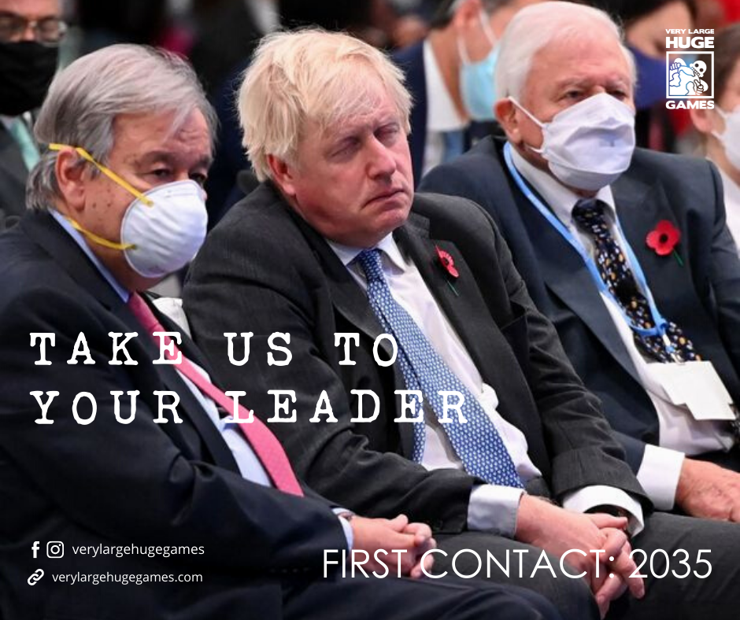
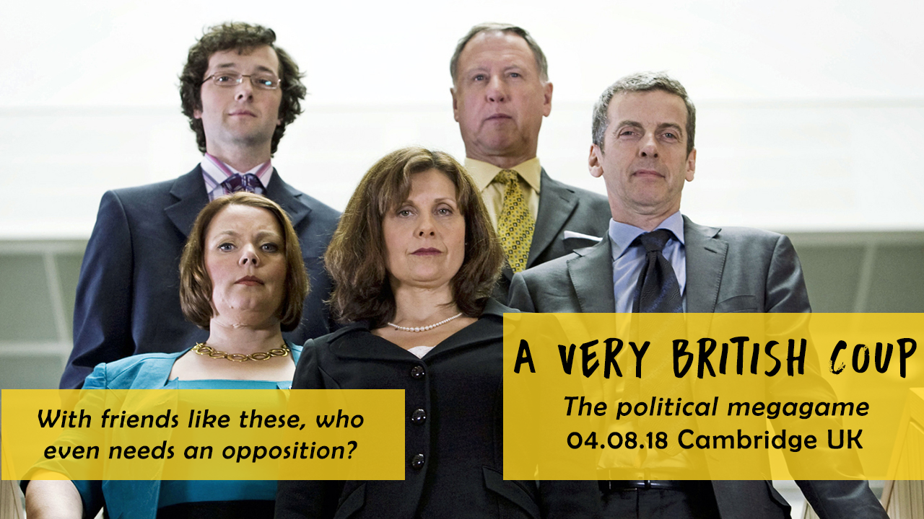
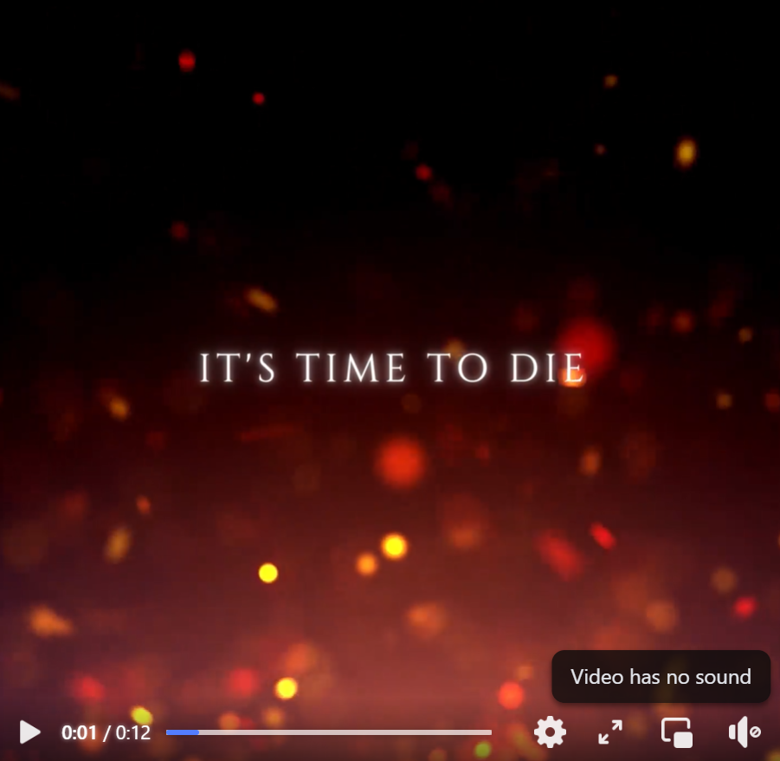
What is marketing?
How to tell a potential audience about your game
It makes them want to play it
Notes:
At its simplest, marketing is about getting your product in front of people in such a way that they want to engage with it. I’ve shared a selection of megagame “posters” here (including a video still), which have all tried to capture a feel about the game they’re promoting in order to excite potential players.

Slide 3
Social Media
You do not need to be active on every platform – Facebook +1 other if you feel it’s of value
Consistency is key – regular posts puts your stuff in peoples’ faces
Do not waste time making content – done is better than perfect
Notes:
Social media is becoming an increasingly fragmented realm, with people on different platforms that may or may not be more useful to you when marketing a megagame. Facebook is still the biggest and likely to yield a lot of attention, so I would advise a presence here – after which, you will know your own capacity, but I would advise no more than one other platform to start off with, if you think it would be useful, and not just another social media account for the sake of it.
In order to get peoples’ attention, a steady stream of material will keep you in front of potential players. It does not have to be amazing and ground breaking, but it should be semi-regular. “Done is better than perfect” when it comes to engaging content, so do not waste time on crafting the best poster, video, or post when you may have other commitments. This does not mean there should be no quality control, but do bear this simple mantra in mind.

Slide 4
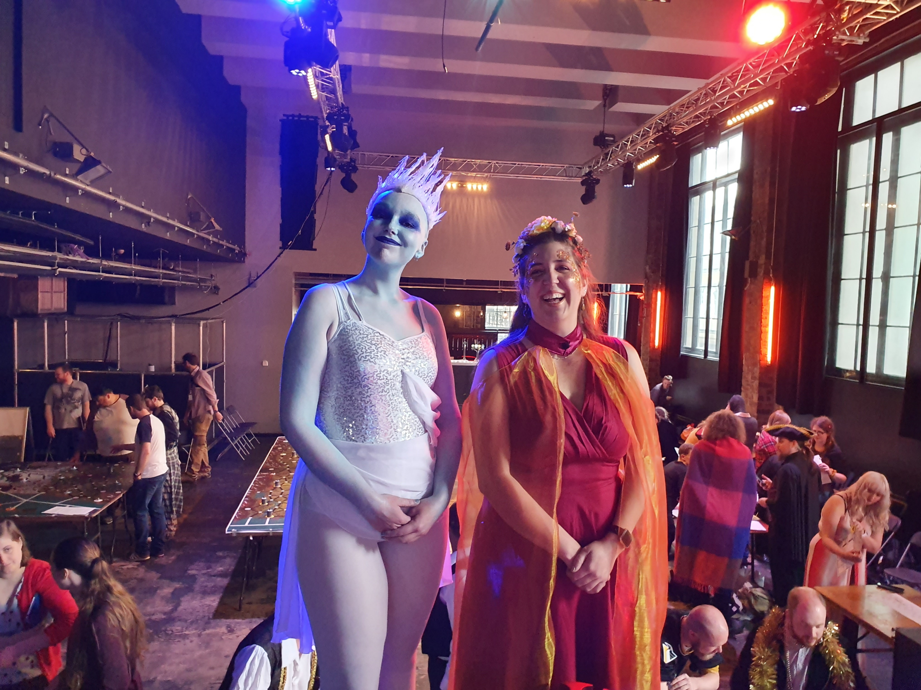
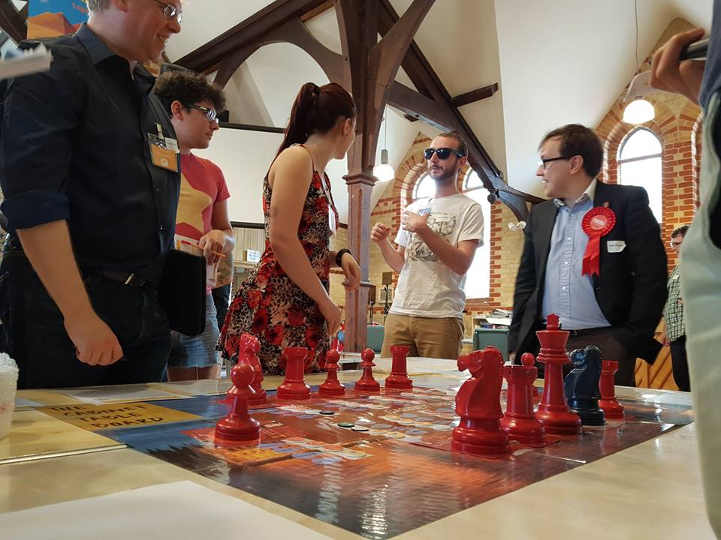
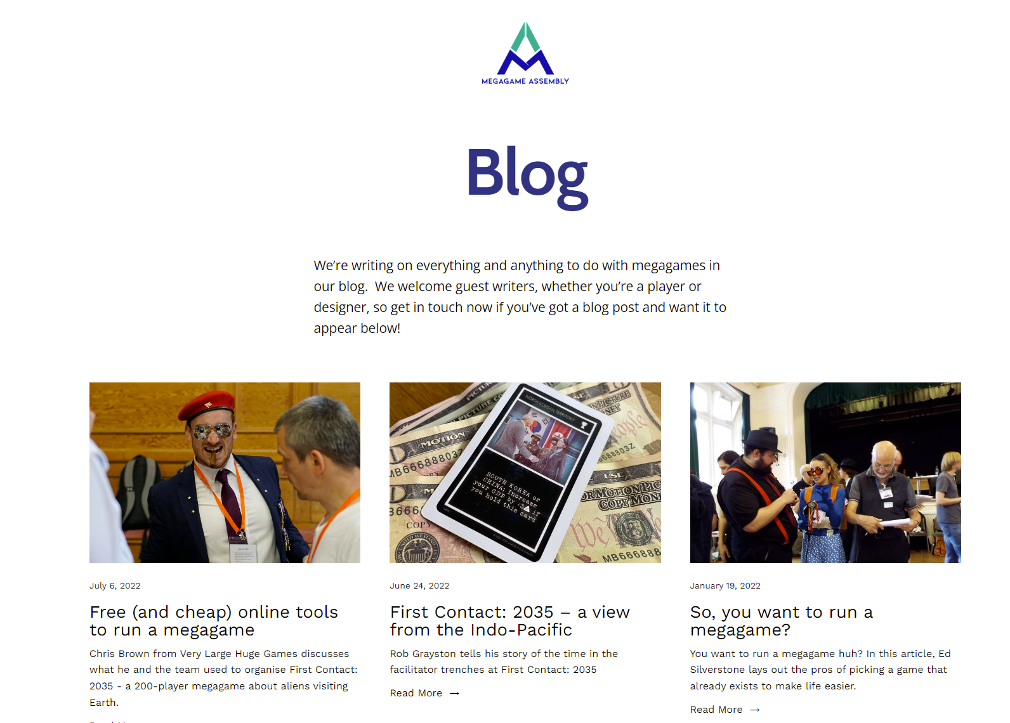
Website
Something to point people at – this could be a Facebook page, megagame group site, or an article on Megagame Assembly – but a website lets you do more yourself.
Signup forms for a game or mailing list
Engaging content, whether it’s a blog post or interesting pictures
Notes:
A digital location to point potential players at is very useful – a place with some details on your own game or group, and contact details. Websites are the best option here, but will need maintenance and updating.
You can use your website as a location for your signup forms, whether to a specific game or a general newsletter.
A website is also somewhere to host engaging material such as past megagame reports, introductions to new games, and pictures from past games that show what they were like. Smiling players and “action shots” are ideal!

Slide 5
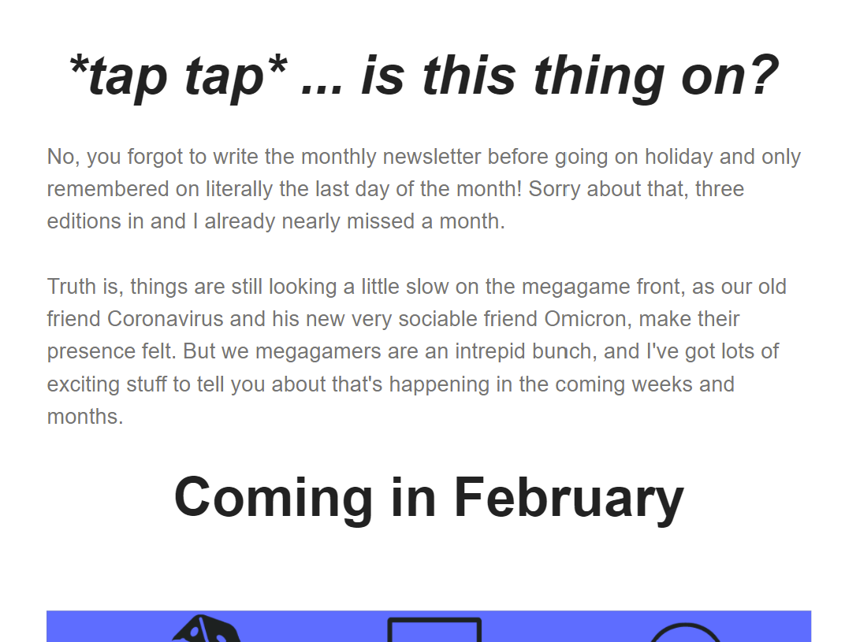
Email list
Sign people up = direct access to their attention
Be mindful of GDPR and do not spam people
Keep emails to the point, only a few links
Useful for a future event
Notes:
As mentioned in the previous slide, you should consider running an email list. It will give you direct access to their inbox, and not rely on people seeing your social media posts “in the wild.”
Nobody likes email spam, so do not abuse running an email list. You should also be mindful of data governance such as GDPR, so make sure you are aware of the relevant laws.
The email content should be to the point; the longer an email, the less people will read – and this includes the fewer links they will click s the email goes on. Key links should be prominent and near the top of an email.
Hopefully you can see the advantage of having an email list, as it can be used to keep potential players informed for your future games.

Slide 6
Existing groups
Research relevant audience – is there a wargames/boardgames club, or LARP group active nearby?
A boardgame café might take fliers or host a playtest
Historical reenactors, university societies, special interest groups (political organisations, MUN, etc.)
Notes:
Megagames are not big enough to be their own independent subset of gaming (yet), and so we need to attract players from other places. Some of these are adjacent to the hobby, like boardgamers, wargamers, LARPers and roleplayers, so start by looking for clubs and groups online and in your area.
If you are fortunate enough to have a boardgame café or other similar space, you should absolutely consider approaching them to take fliers or host a playtest. A playtest can be a lot of work, but it can give you visibility with potential players, build a relationship with the café that can be mutually beneficial, and you can post about it/take pictures too! Other places to find potential players may be fan groups of a specific intellectual property, historical re-enactors, Model United Nations clubs, and university societies. Go wild on Google looking at who is out there!

Slide 7
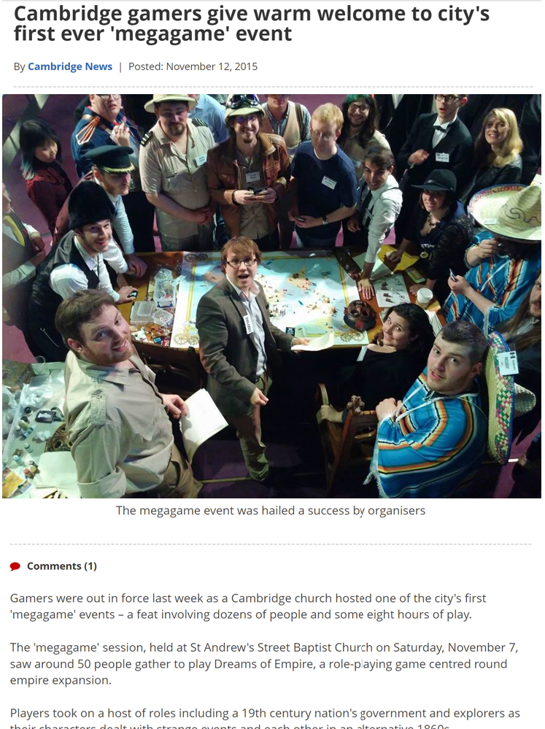
Miscellanea
Radio, newspapers, community comms. resources
Playtests can generate content and hype – look after your cheerleaders
There is no marketing silver bullet – it also cannot fix other flaws in a megagame
Ask for help – resources and advice are out there
Notes:
Traditional media can seem daunting, but many local news outlets such as radio stations and newspapers may be open to hearing about your game. Community media at a low level (church newsletters, parish magazines, neighbourhood Facebook groups) can also be a potential source to get a few players. Leave no stone unturned!
As mentioned previously, playtests can take some effort to arrange but are good places to run short taster sessions and engage with your most enthusiastic players (or “cheerleaders”), who in turn will tell their friends and share your content.
But the main thing to remember, above all, even moreso than “Done is better than perfect,” is that there is no single megagame marketing Silver Bullet to make everything you do work flawlessly. Perhaps physical posters at some locations might be good for you, whilst a Discord with active posting might work for someone else? Also bear in mind that no matter how big the hype is around the game, marketing cannot hide anything that goes wrong!
Finally, don’t be afraid to ask for help. There are friendly megagamers out there who have done what you want to do, and who will be happy to give advice and perhaps provide some time and skills.

Slide 8
Questions & Comments
Thanks for attending this run through of some foundational elements for marketing in megagames! Marketing methods and tools change all the time, so be prepared to adapt and do what works best for your megagame to succeed.
We’ve looked at the basics – so now what do you think?
Notes:
Thanks for sitting through this basic run-through of marketing for megagames!
Marketing is more of an art than a science, and you will find what works best for you – ultimately, this introductory presentation may not have given you any help beyond thinking you will ignore it, and find new and effective ways to get the megagaming message out to potential players. I’m still counting that as a win.
Any questions?

